Slide 1
HUBzero Platform Features TRADES Proposal Demo Oct. 12, 2016 Derrick Kearney hubzero.org

Slide 2
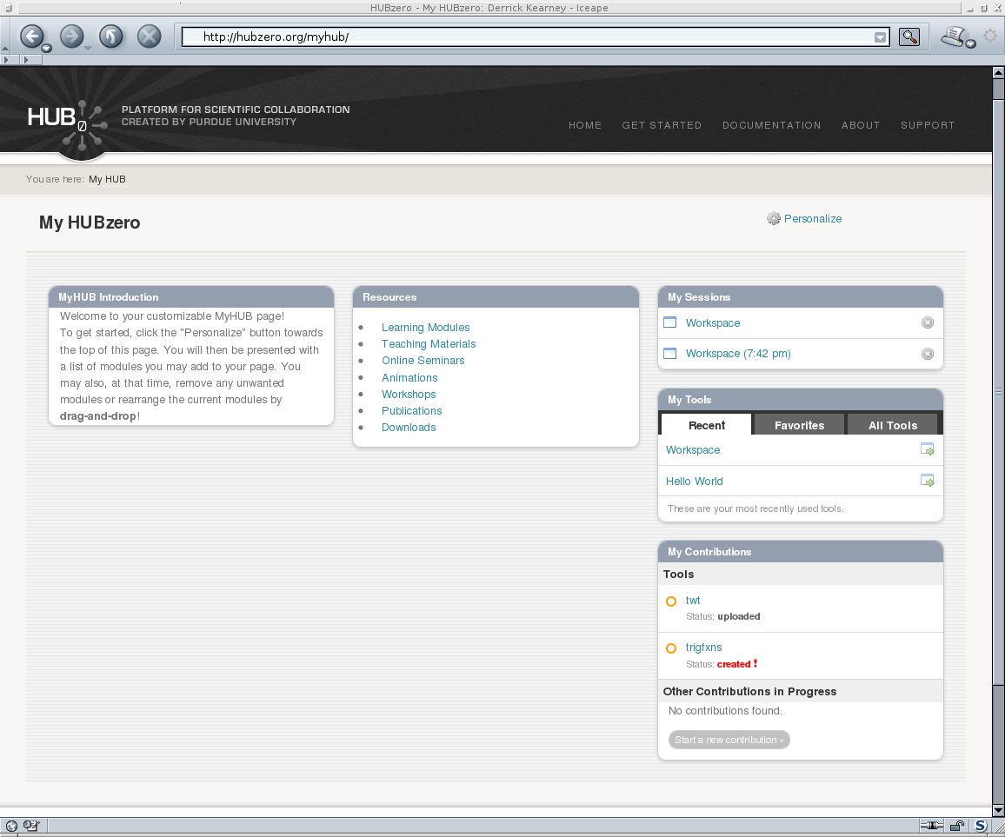
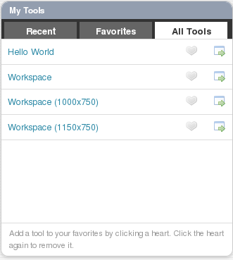
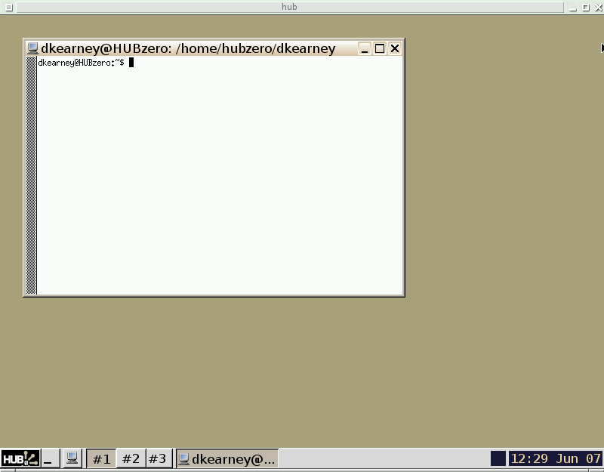
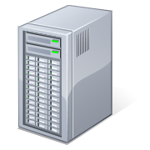
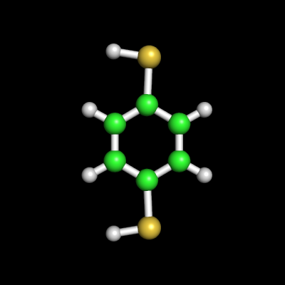
The HUBzero Platform
User's Web Browser
HUBzero Infrastructure
Web Server
Middleware
Grid
Submit
Proxy
Tool Session
Containers
Visualization

Slide 3
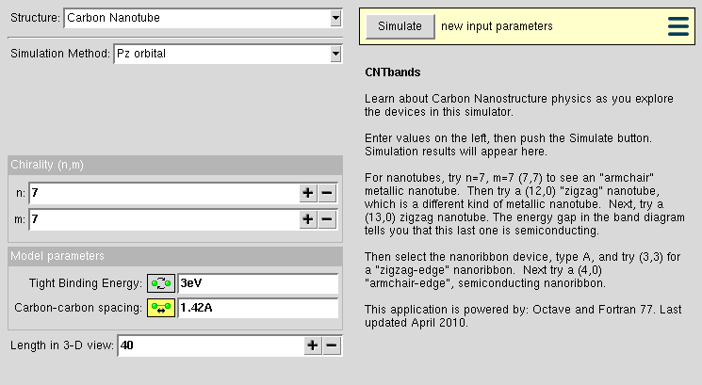
CNTbands
CNTbands
Science Domain: Nanoelectronics
Scientists: Lundstrom et al. (Purdue)
https://nanohub.org/resources/cntbands-ext

Slide 4
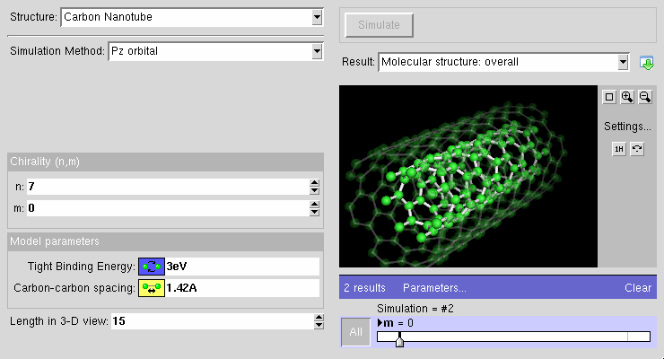
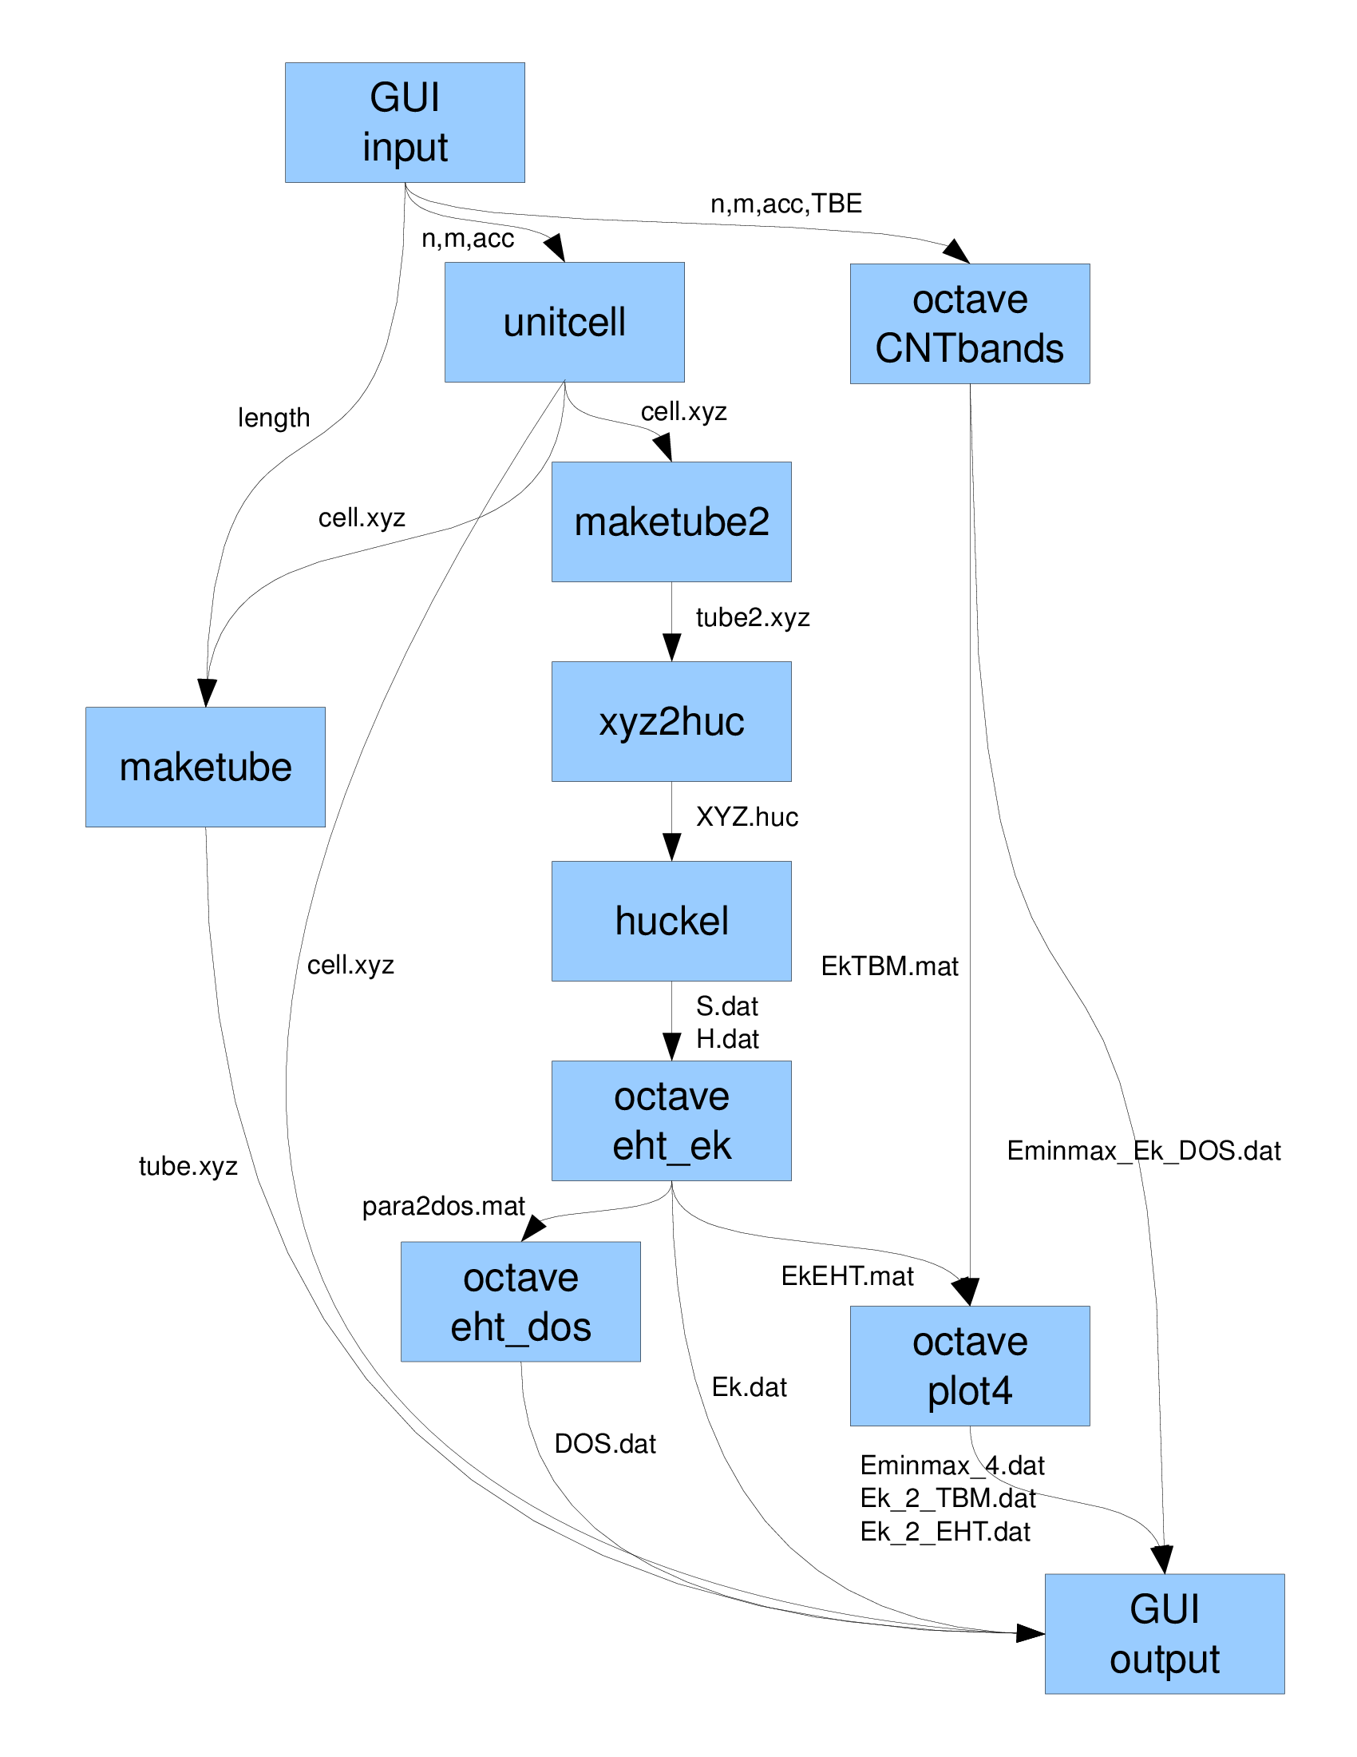
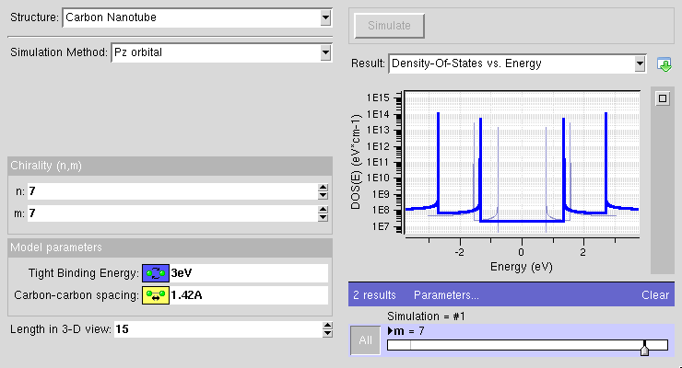
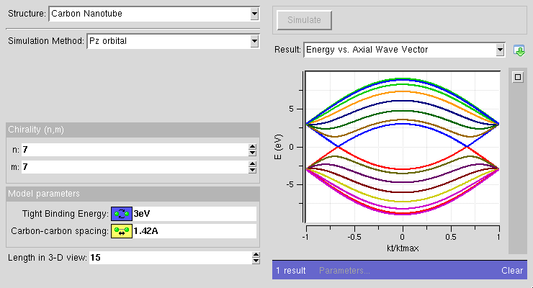
CNTbands
CNTbands
Science Domain: Nanoelectronics
Scientists: Lundstrom et al. (Purdue)
https://nanohub.org/resources/cntbands-ext

Slide 5
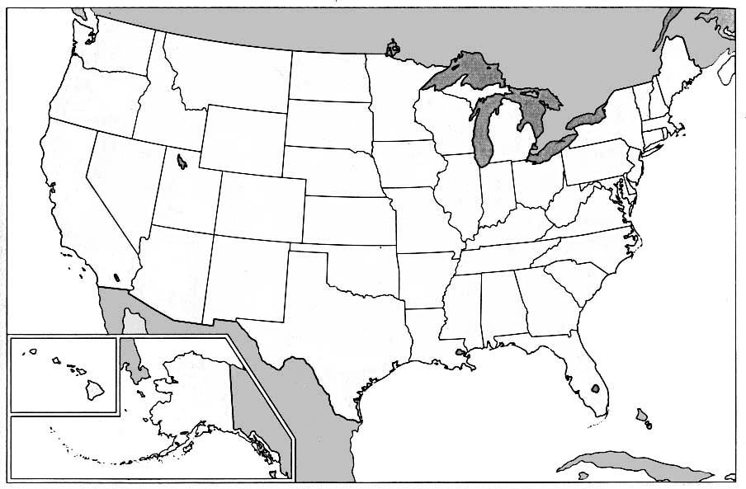
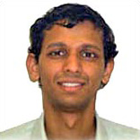

1990s – Pre CNTbands
M.P. Anantram
Ph.D Student
NanoStructures

Slide 6
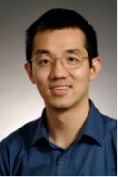
2002 – CNTbands Ideas
M.P. Anantram
Ph.D Student
NanoStructures
Jing Guo
Ph.D Student
Carbon Nanotubes

Slide 7
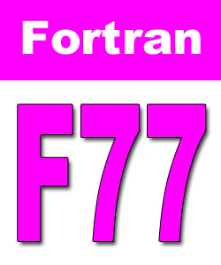

2002 – CNTbands Registered
Jing Guo
Ph.D Student
Carbon Nanotubes
M.P. Anantram
Ph.D Student
NanoStructures

Slide 8
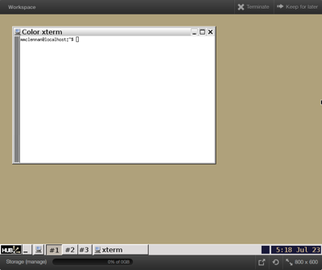
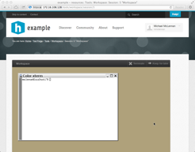

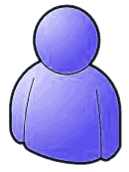


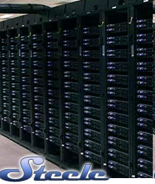

What is a workspace?
Full-featured Linux desktop
For tool developers
For researchers
Accessible from any web browser
Still running after you close your browser
Access to computational clusters
File storage provided by the hub
local
clusters
File server
<number>

Slide 9
CNTbands
CNTbands
Science Domain: Nanoelectronics
Scientists: Lundstrom et al. (Purdue)
https://nanohub.org/resources/cntbands-ext

Slide 10
Collaboration / Groups

Slide 11
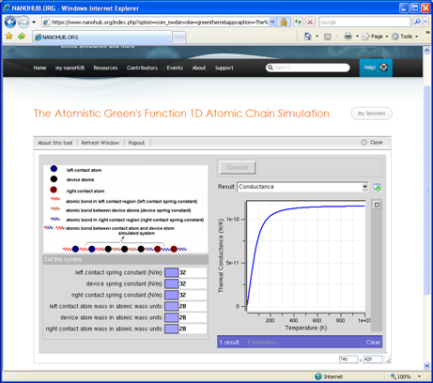
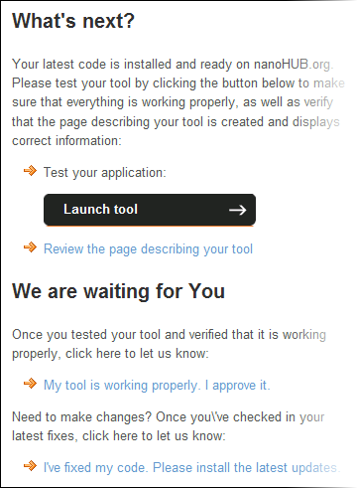
Installing & Testing Applications
waiting for…
User
Hub managers
Contribution form
Registered
Created
Uploaded
Installed
Updated
Approved
Published
Retired

Slide 12
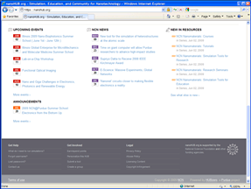
CNTbands is Published
waiting for…
User
Hub managers
Contribution form
Registered
Created
Uploaded
Installed
Updated
Approved
Published
Retired

Slide 13
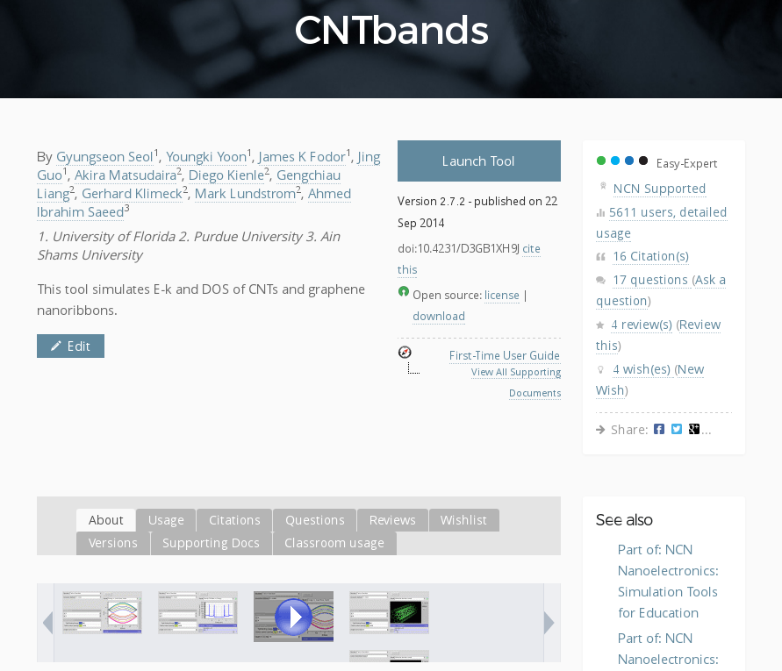
Knowing your impact

Slide 14
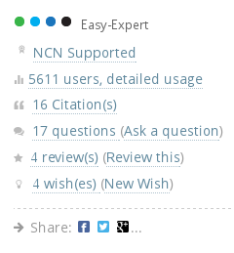
Communicate with users

Slide 15
New feature added
CNTbands
Science Domain: Nanoelectronics
Scientists: Lundstrom et al. (Purdue)
https://nanohub.org/resources/cntbands-ext

Slide 16
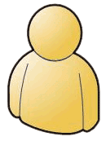
2010 – New Grad Students
New Grad Student
Graphene
NanoRibbons
M.P. Anantram
Ph.D Student
NanoStructures
Jing Guo
Ph.D Student
Carbon Nanotubes

Slide 17
Collaboration inside the Workspace
New Grad Student
Graphene
NanoRibbons
M.P. Anantram
Ph.D Student
NanoStructures
Jing Guo
Ph.D Student
Carbon Nanotubes

Slide 18
Collaboration inside the Workspace
New Grad Student
Graphene
NanoRibbons
M.P. Anantram
Ph.D Student
NanoStructures
Jing Guo
Ph.D Student
Carbon Nanotubes

Slide 19
Collaboration inside the Workspace
New Grad Student
Graphene
NanoRibbons
M.P. Anantram
Ph.D Student
NanoStructures
Jing Guo
Ph.D Student
Carbon Nanotubes

Slide 20
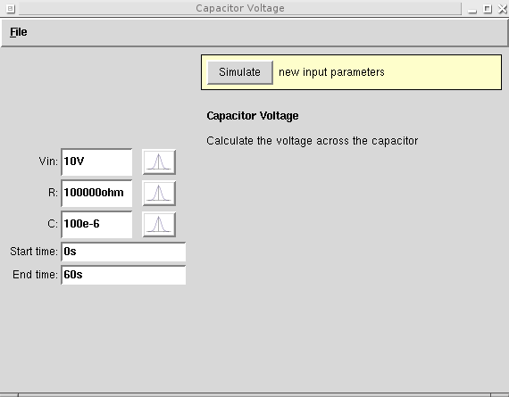
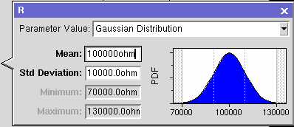

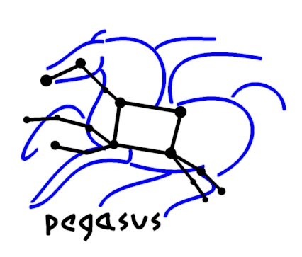
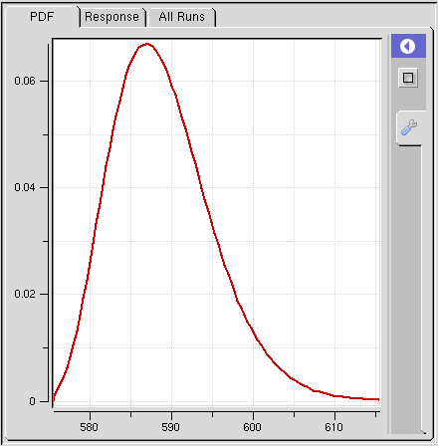
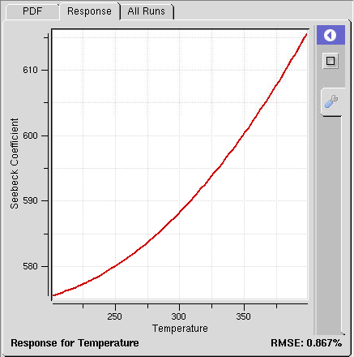
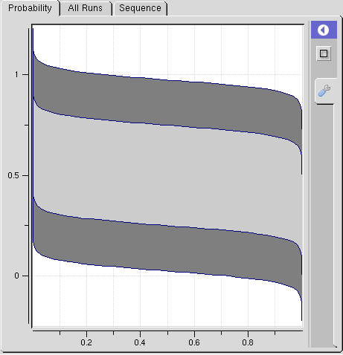
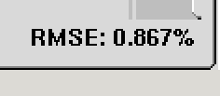
Productivity in the Workspace
Pegasus Workflows
Uncertainty Quantification
Submit
DAX
HUBzero Infrastructure
Tool Session
Containers
Submit
Proxy
Grid
Grid
Grid
Proxy
DAG
Grid
Grid
Grid
Grid
Notes:
While hubcheck library development has slowed over the last few months, there is still work to be done.
First, we need to continue to build more page objects to cover the web interface.
Need to put together a Debian package for easier installation of the software.
And we need to release the open source code in a hubzero repository connected to GitHub so others can use it.

Slide 21


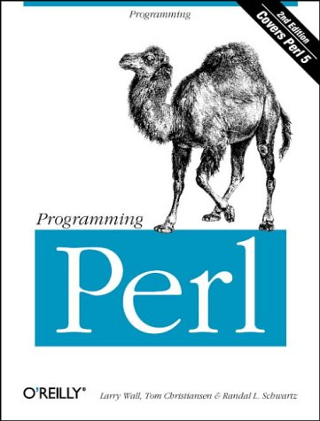
Pegasus Workflow Management
DAX
HUBzero Infrastructure
Developed at USC
Ewa Deelman et al.
Website: pegasus.isi.edu
Manage jobs on the grid
Open Source
Bindings for your
favorite languages:
Tool Session
Containers
Submit
Proxy
Grid
Grid
Grid
DAG
Benefits:
Performance
Portability
Provenance
Data Management
Error Recovery
Grid
Grid

Slide 22
Let Submit create a workflow ...
User's Workspace Terminal
HUBzero Infrastructure
$ submit -p @@Vin=1-5 ./sim1.py --Vin @@Vin
scatter
Tool Session
Containers
Submit
Proxy
Vin=1
Vin=2
...
Vin=5
Grid
Grid
Grid
Grid
Grid
Grid
gather

Slide 23
… or write your own workflow
CNTBands
Science Domain: Nanoelectronics
Scientists: Lundstrom et al. (Purdue)
https://nanohub.org/resources/cntbands-ext

Slide 24
Productivity in the Workspace
Pegasus Workflows
Uncertainty Quantification
Submit
DAX
HUBzero Infrastructure
Tool Session
Containers
Submit
Proxy
Grid
Grid
Grid
Proxy
DAG
Grid
Grid
Grid
Grid
Notes:
While hubcheck library development has slowed over the last few months, there is still work to be done.
First, we need to continue to build more page objects to cover the web interface.
Need to put together a Debian package for easier installation of the software.
And we need to release the open source code in a hubzero repository connected to GitHub so others can use it.

Slide 25
Productivity in the Workspace
Pegasus Workflows
Uncertainty Quantification
Submit
DAX
HUBzero Infrastructure
Tool Session
Containers
Submit
Proxy
Grid
Grid
Grid
Proxy
DAG
Grid
Grid
Grid
Grid
Notes:
While hubcheck library development has slowed over the last few months, there is still work to be done.
First, we need to continue to build more page objects to cover the web interface.
Need to put together a Debian package for easier installation of the software.
And we need to release the open source code in a hubzero repository connected to GitHub so others can use it.

Slide 26
Running locally in a Workspace
User's Workspace Terminal
HUBzero Infrastructure
$ echo hi
hi
$
Tool Session
Containers
Submit
Proxy
Grid
Grid
Grid
Grid
Grid
Grid

Slide 27
Submitting from a Workspace
User's Workspace Terminal
HUBzero Infrastructure
$ submit echo hi
Tool Session
Containers
Submit
Proxy
Grid
Grid
Grid
Grid
Grid
Grid

